Slide 1

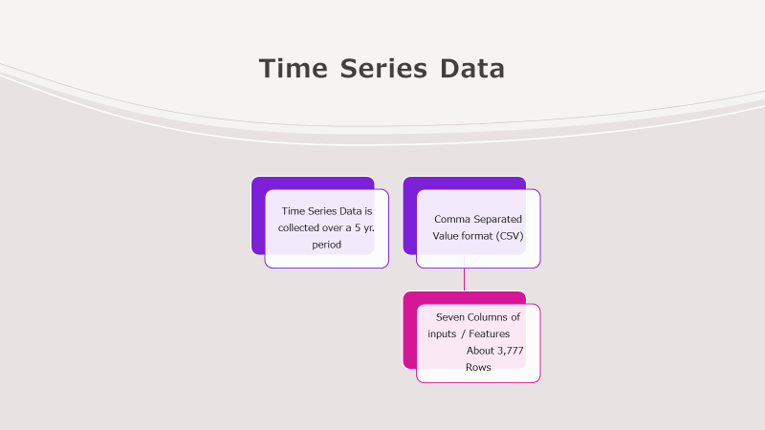
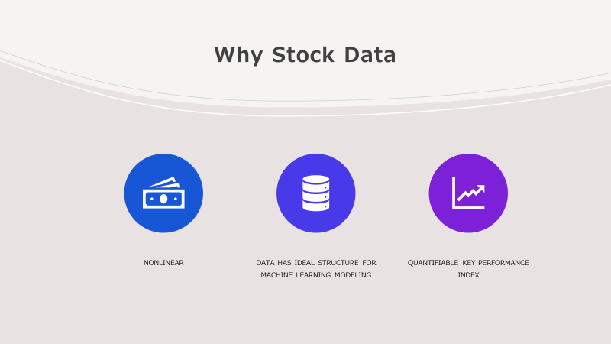
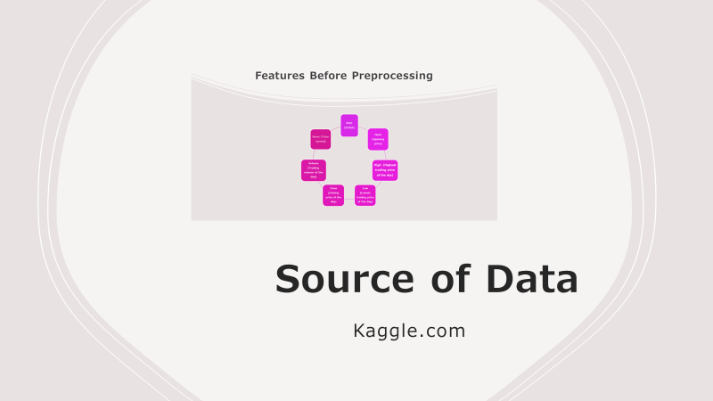
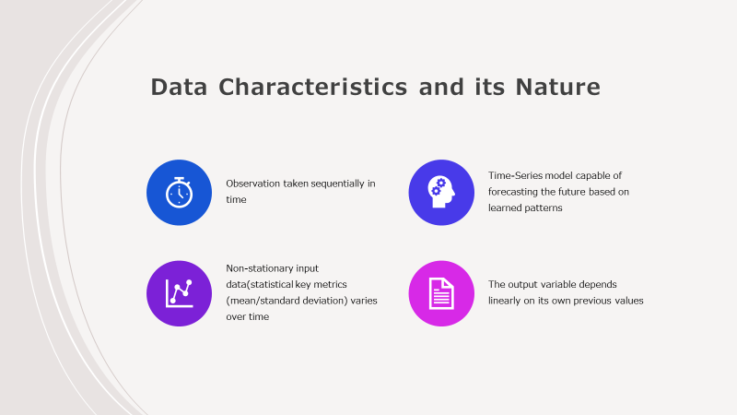
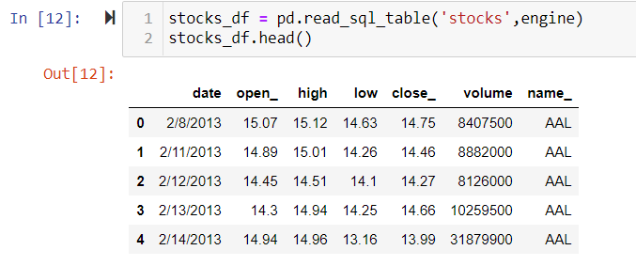
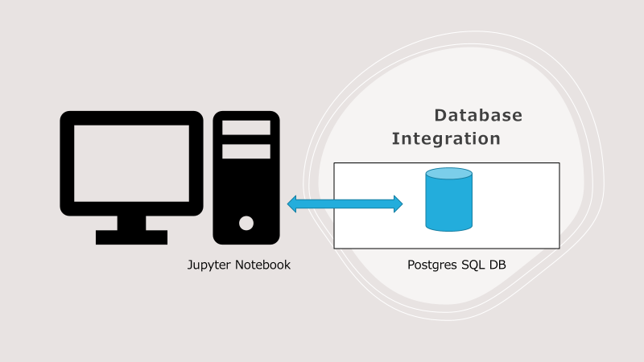
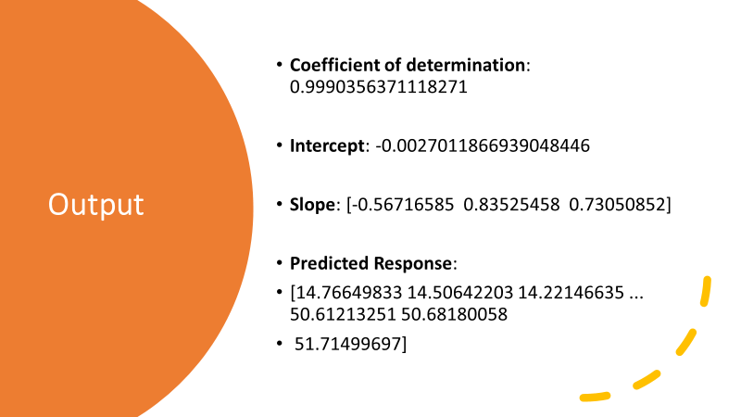
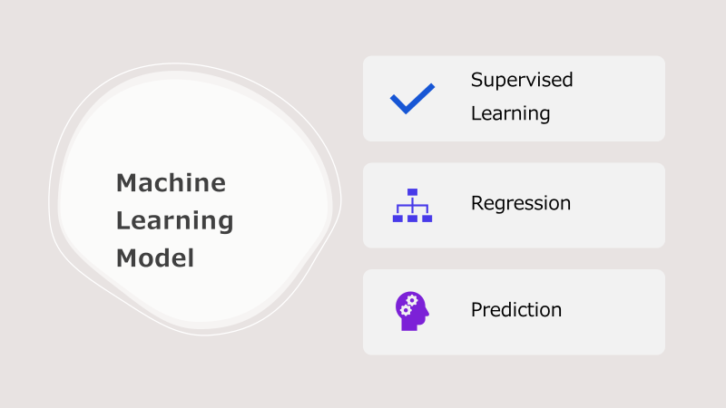

Slide 5
Why Stock Data
help understand past trends so we can forecast FUTURE
Data has ideal structure for Machine Learning modeling
Quantifiable Key Performance Index

Slide 9
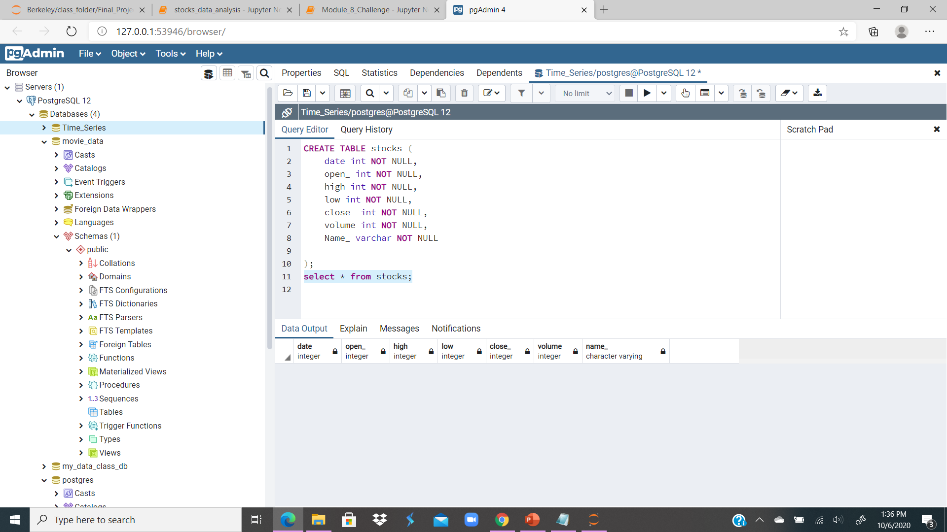

Slide 11

Model and Functions
Linear Regression - Continuous dependent variable
Preprocess the data
Create a model - model = LinearRegression()
Fit it-model.fit(x, y)
r_sq - model.score(x, y)
Predict Response – y_pred = model.predict(X)

Slide 12
Output
Coefficient of determination: 0.9990356371118271
Intercept: -0.0027011866939048446
Slope: [-0.56716585 0.83525458 0.73050852]
Predicted Response:
[14.76649833 14.50642203 14.22146635 ... 50.61213251 50.68180058
51.71499697]

Slide 13
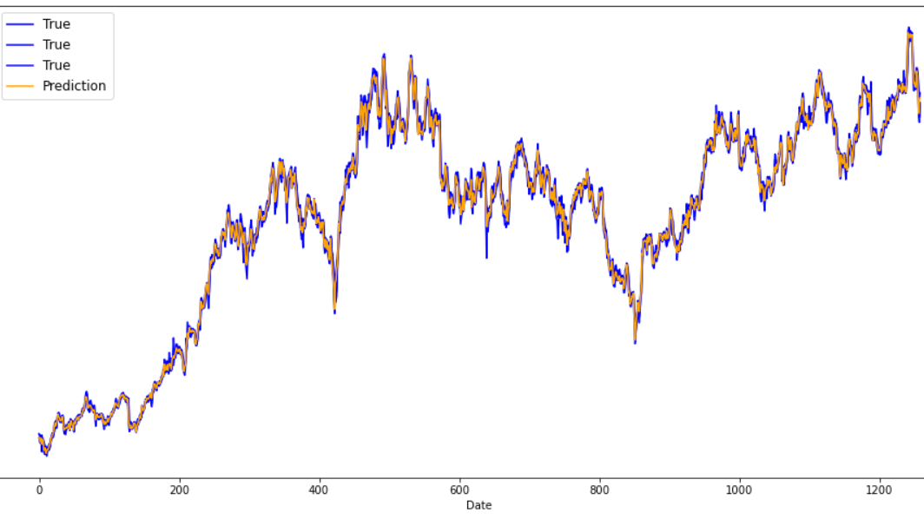
Input/Output Plot

Slide 14

Risks and future work
Prediction in this experiment is a demonstration
More work is required –
User Interface Menu with stock symbol to be predicted
Timeframe for test and prediction
Mobile application
Most time series data

Slide 15
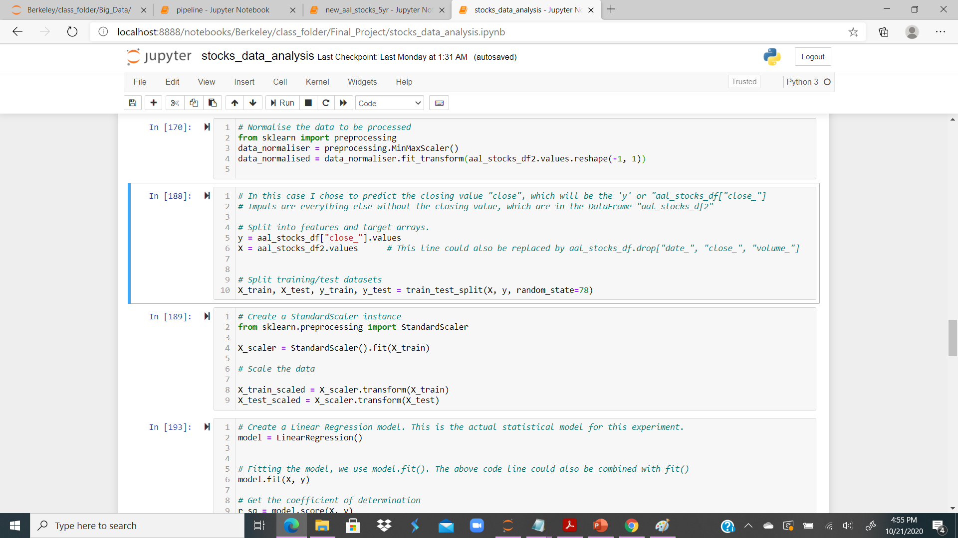
Code Sample 1

Slide 16
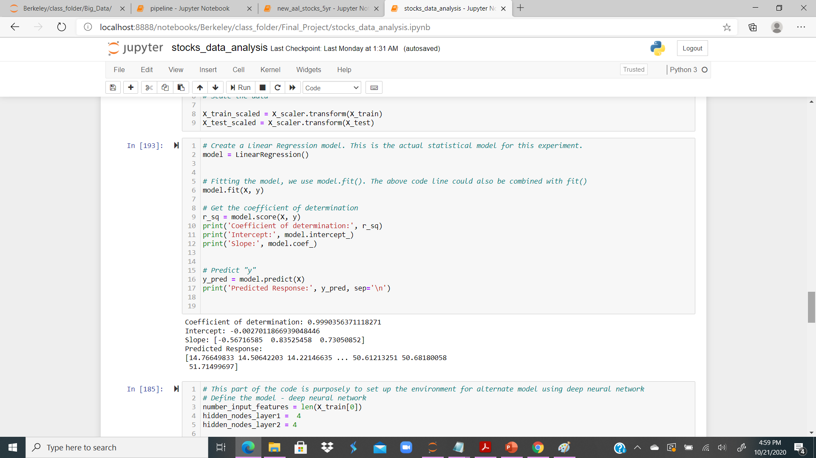
Code Sample 2

Slide 17
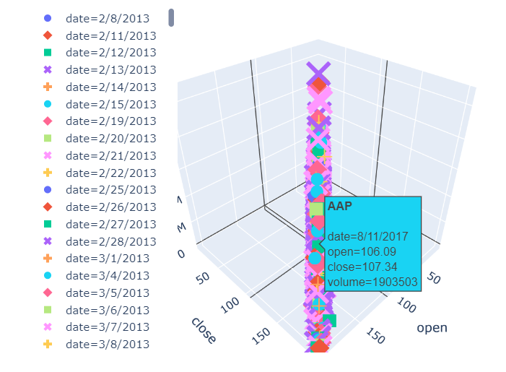
AAP

Slide 18
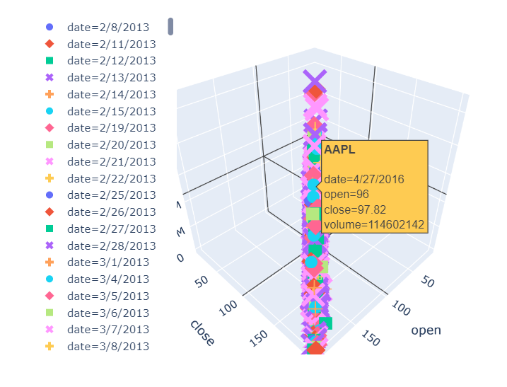
AAPL

Slide 19
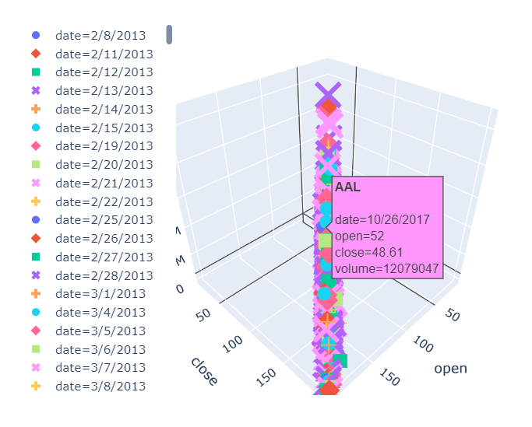
AAPL

